Slide 1
SOLID WASTE MANAGEMENT IN INDIA
By:- Shani Bharadwaj

Slide 2
INTRODUCTION
Solid Waste Management (SWM) is a critical challenge faced by modern urban and rural communities, especially in a rapidly developing country like India. With a population exceeding 1.4 billion, the generation of waste has increased exponentially, straining existing waste management systems. Effective solid waste management is essential to mitigate these challenges, encompassing the collection, segregation, treatment, and proper disposal of waste.

Slide 3
Current state of solid waste in India.

Slide 4
Staggering Waste Generation
India produces approximately 62 million tons of municipal solid waste annually, projected to reach 165 million tons by 2030 and 436 million tons by 2050.
Inefficient Collection and Disposal
Only 75-80% of municipal waste is collected in urban areas, while rural areas often lack systematic waste collection mechanisms.
Of the collected waste, only 30-40% is scientifically processed; the rest is dumped in open landfills
Lack of Infrastructure
Many cities and towns lack the necessary infrastructure, resources, and management systems to handle the growing waste effectively.
.

Slide 5
Sources of Solid Waste.

Slide 6
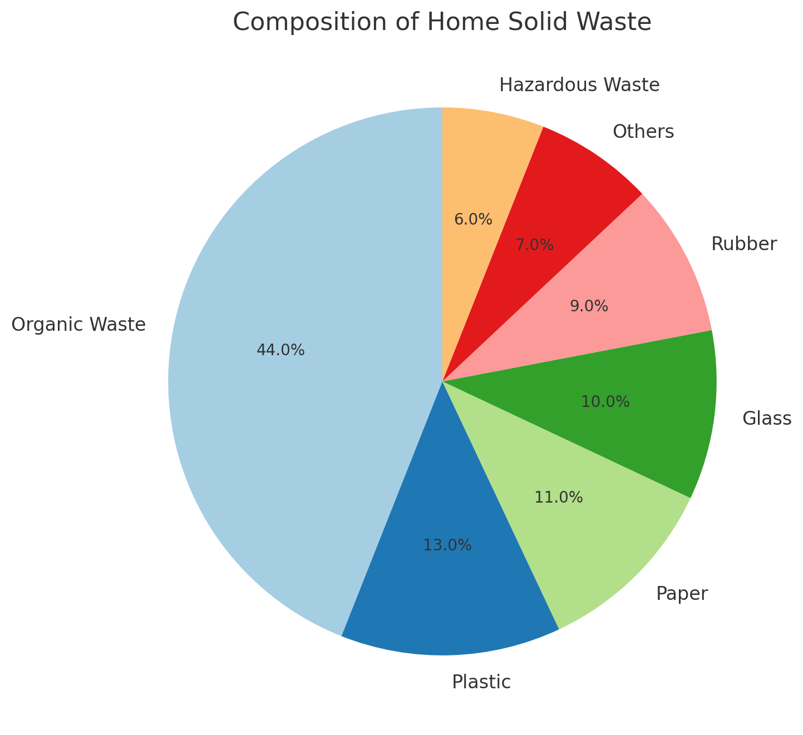
In India , Solid waste is categorized into six components by law:
Municipal solid waste
Hazardous waste
E-Waste
Bio-Medical waste
Plastic waste
Construction and demolition waste

Slide 7
Challenges in Solid Waste Management
Inadequate Infrastructure
Limited collection, transportation, and disposal facilities hinder effective waste management.
Lack of Awareness and Participation
Public awareness and involvement in proper waste segregation and disposal practices are often lacking.
Financial Constraints
Insufficient funding and resources make it challenging for local authorities to invest in sustainable waste management systems.

Slide 8
Waste Collection and Segregation

Slide 9
Door-to-Door Collection
Improving the coverage and frequency of door-to-door waste collection is crucial for effective waste management.
Source Segregation
Encouraging households and businesses to segregate waste into organic, recyclable, and non-recyclable fractions is key.
Community Involvement
Engaging local communities and organizations in waste management initiatives can improve collection and segregation efforts.
Decentralized Approach
Implementing decentralized waste management systems at the community level can enhance efficiency and sustainability.

Slide 10
Waste Treatment and Disposal Methods
Composting
Transforming organic waste into nutrient-rich soil through aerobic decomposition.
Recycling
Recovering and reprocessing recyclable materials like plastic, paper, and metal.
Sanitary Landfilling
Scientifically engineered disposal of non-recyclable and non-biodegradable waste.
Waste-to-Energy
Converting non-recyclable waste into electricity or fuel through thermal treatment.

Slide 11
Sustainable Waste Management Practices
Awareness and Education
Promoting public awareness and participation in sustainable waste management practices.
Policy and Regulation
Strengthening policies, regulations, and enforcement mechanisms for effective waste management.
Innovative Technologies
Adopting advanced,
environmentally-friendly technologies for waste processing and disposal.
Collaborative Approach
Fostering partnerships between government, private sector, and communities for integrated waste management.

Slide 12
Refuse what you do not need;reduce what you do need;reuse what you consume;recycle what you cannot refuse,reduce or reuse and rot the rest.
Thank you.

